Slide 1
CNENGR 228 Digital Electronics
Tutorial
By
Dr Zhongming Zhang
School of Engineering

Slide 2
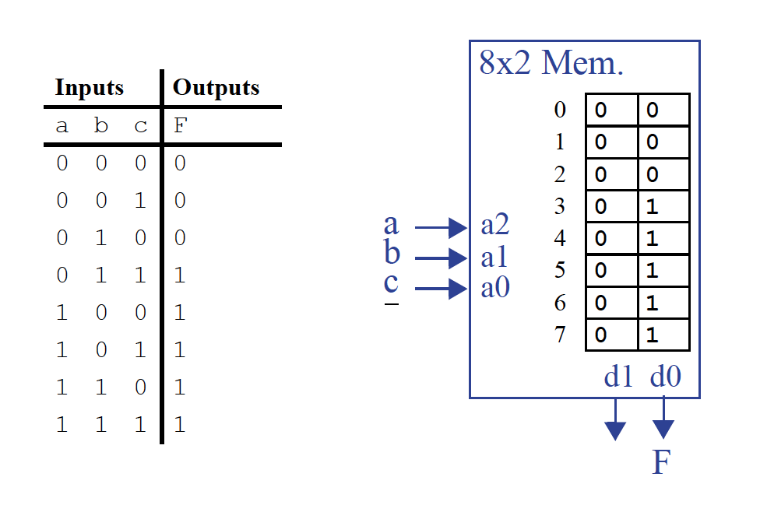

Slide 3
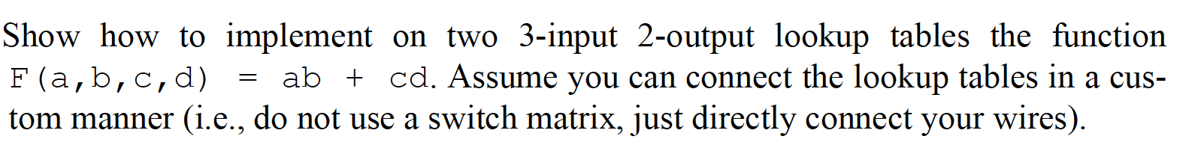
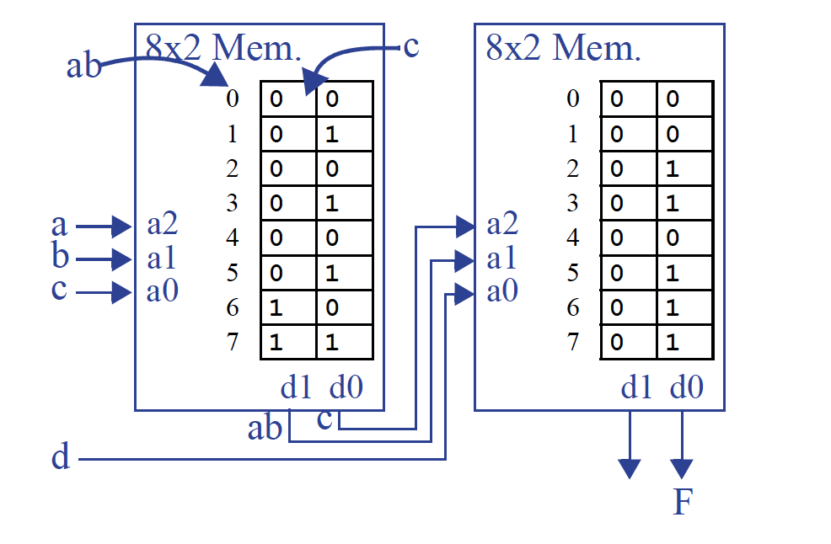

Slide 4
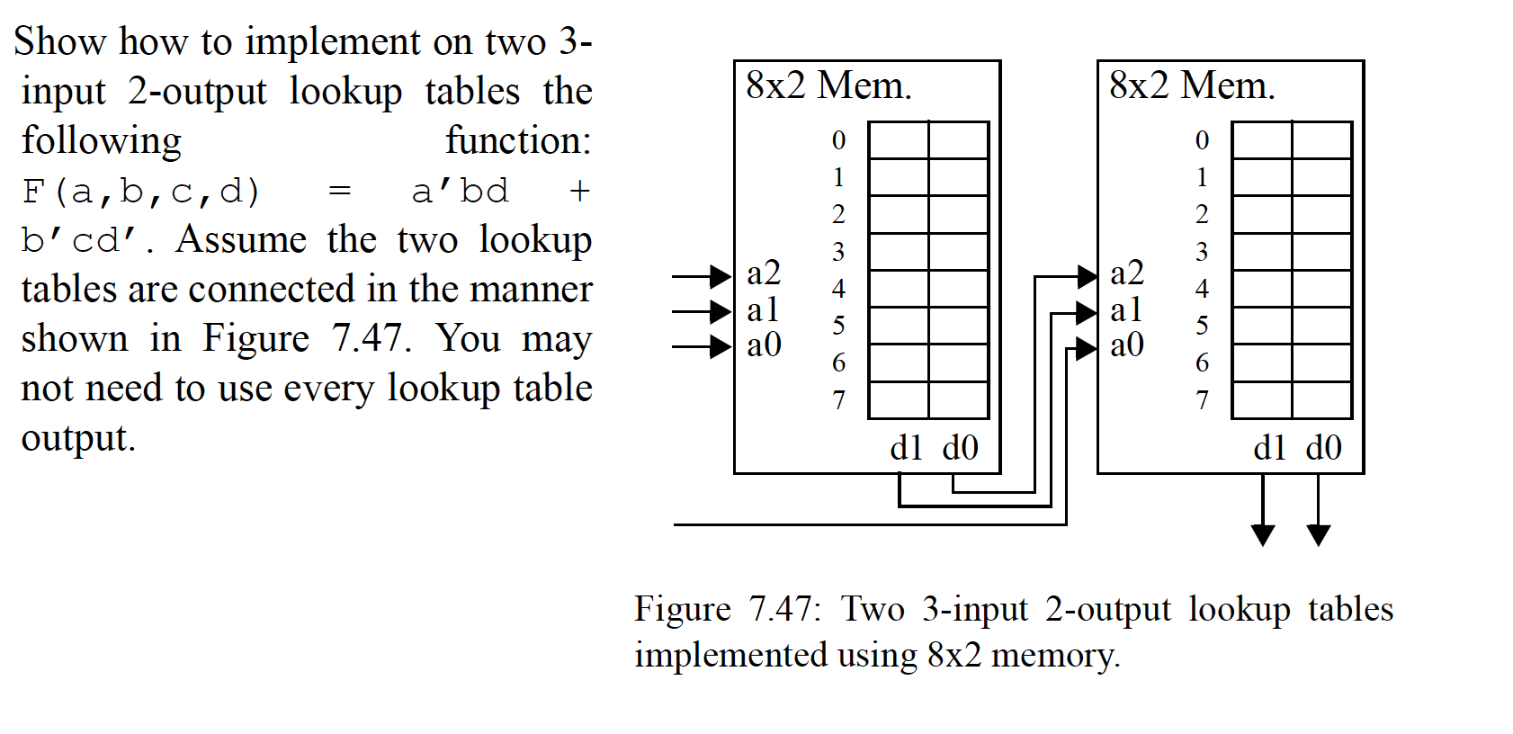

Slide 5
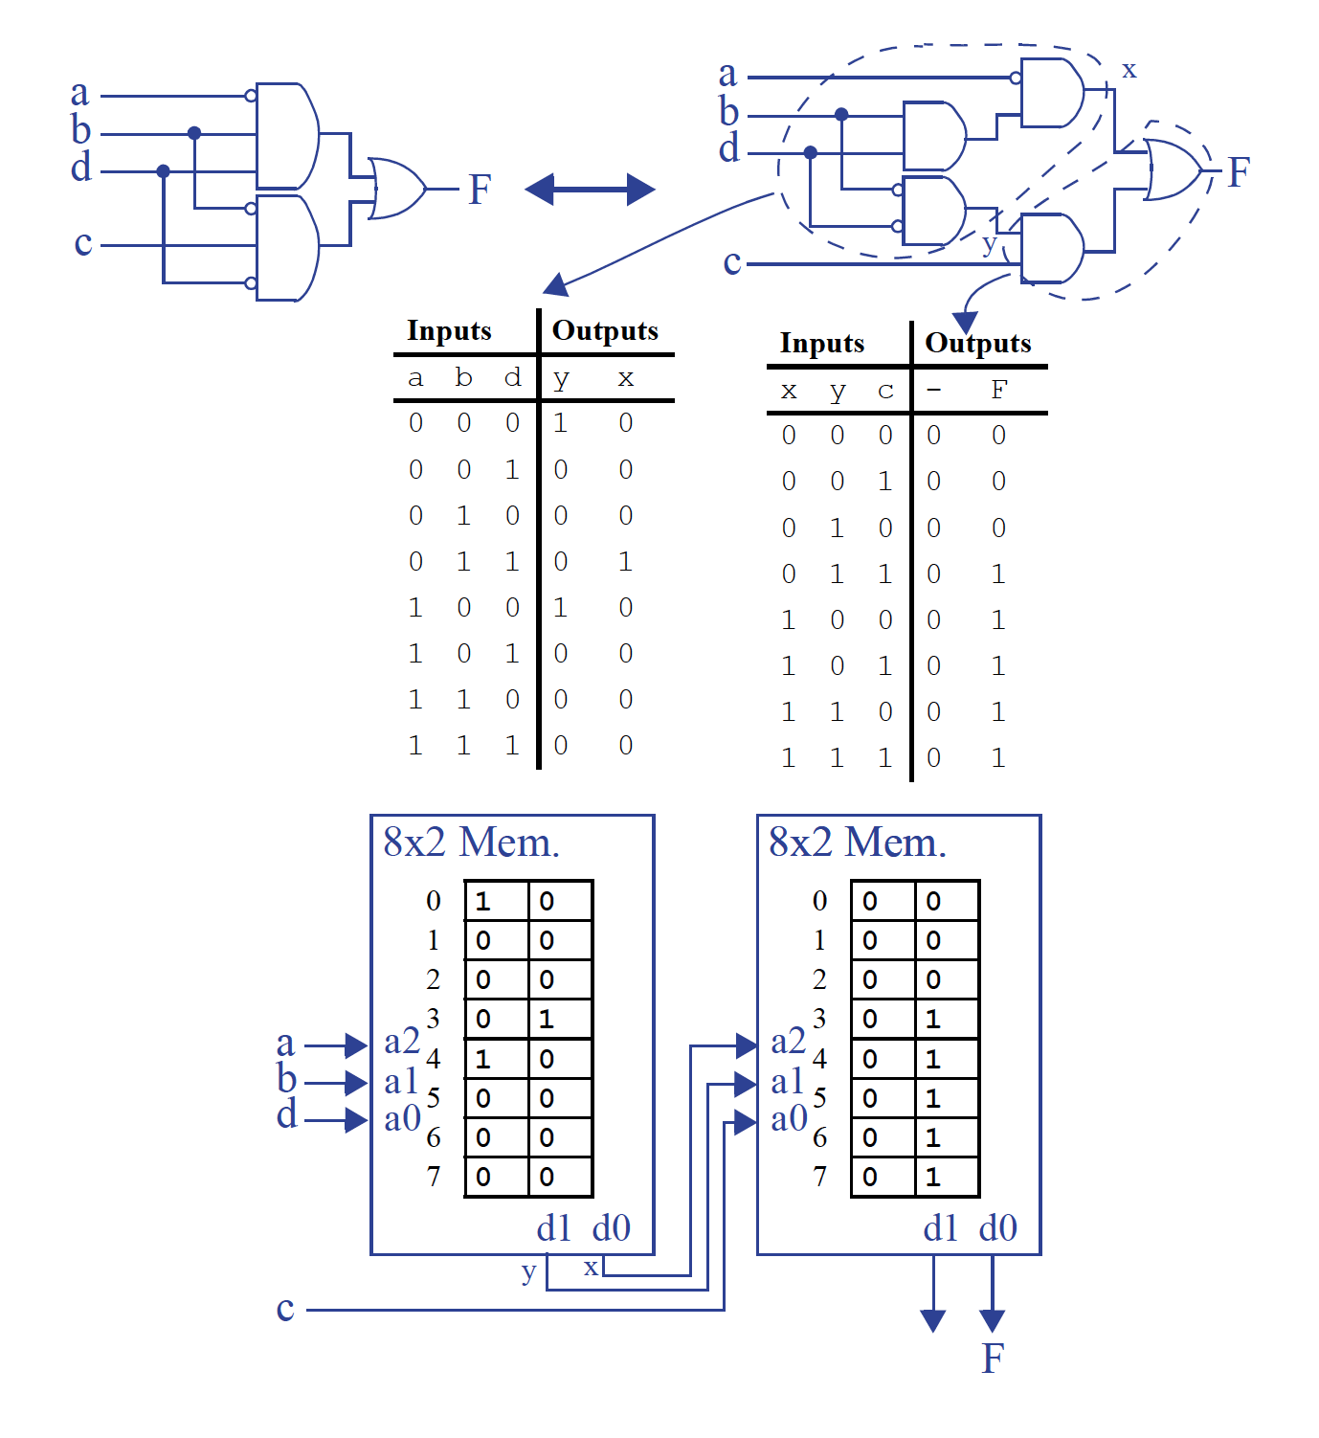

Slide 6
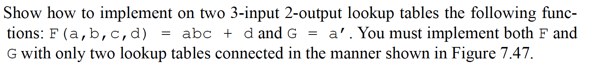
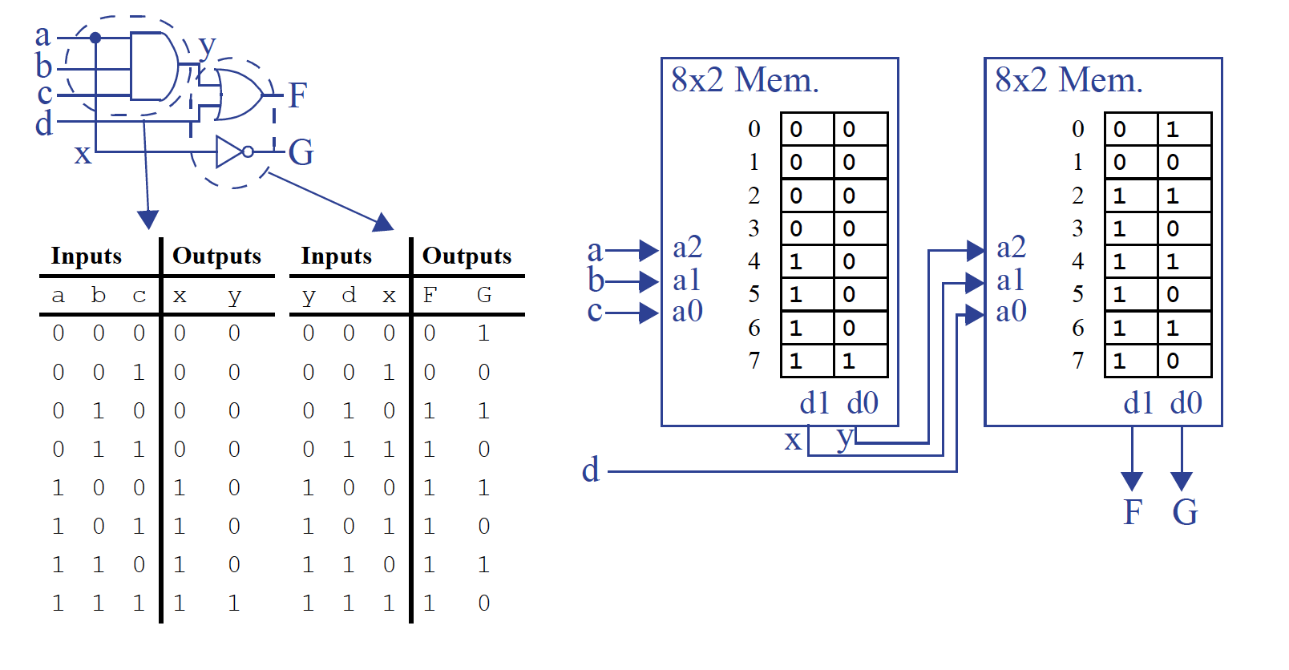

Slide 7
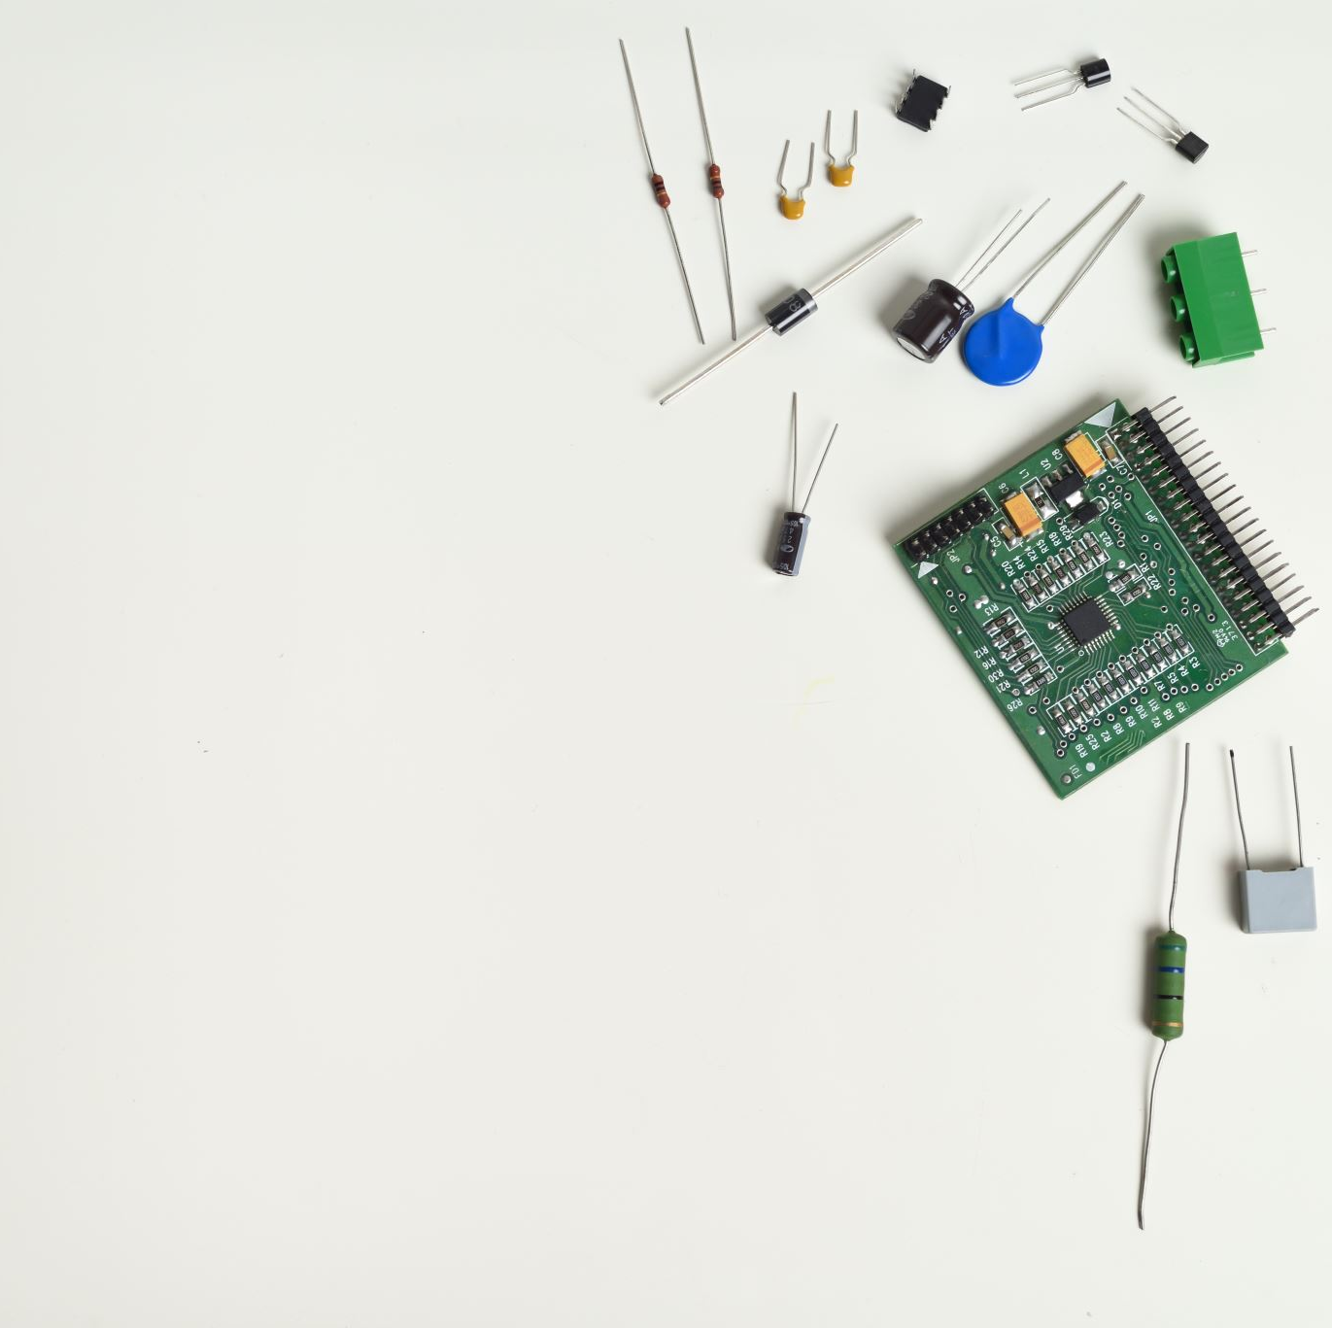
Debate
In today's society, are hardware engineers more important or software engineers more important?
Proposition: Hardware engineers are more important
Opposition: Software engineers are more important
Notes:
Alright class, that was a lively and insightful debate! As your lecturer for *Digital Electronics*, I want to add a final perspective, especially since our course focuses heavily on **FPGA** design.
What makes this debate so fascinating for us is that the **FPGA sits precisely at the convergence point of hardware and software**.
Think about it:
* You **program** the chip, which feels like software. You write code in HDLs like VHDL or Verilog.
* But you are **designing digital circuits**, which is the core of hardware engineering. You are defining the actual logic gates, registers, and data paths.
So, rather than choosing a side, this debate highlights the unique and powerful skill set you are developing. You are not *just* hardware engineers and not *just* software engineers. You are learning to be **architects of both**.
This ability to think across the boundary—to understand how a software algorithm can be directly implemented in silicon—is what makes digital electronics and FPGA design so critical. It's the key to creating efficient, high-speed, and innovative solutions for everything from AI accelerators to advanced communication systems.
My conclusion for you is this: **The most important engineer is the one who understands both.** Don't see them as separate worlds. Embrace the synergy. The depth of understanding you gain in this course about how hardware *actually* works will make you a better programmer, designer, and problem-solver, no matter which path you choose to follow.
Excellent work today, everyone. I'm excited to see the systems you will all design and build.

